Slide 1
Inter Professional Learning
Colombo
Sri Lanka 2018
Dr Leeanne Bodkin
leeannebodkin@abdn.ac.uk
Notes:
Draw on research and also on my experience interprofessional learning in Aberdeen where the UoA collaborates with Robert Gordon University to enable opportunies to be provided for health and social care students to learn together.

Slide 2
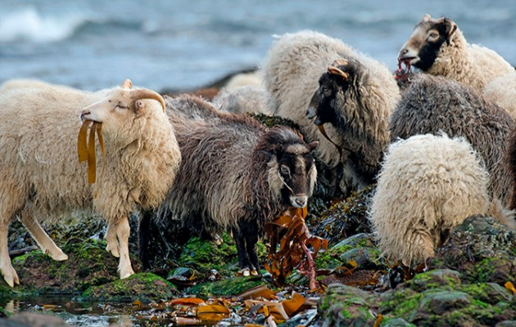
Multi Disciplinary or Inter Professional?
Notes:
Firstly to explain my use of Inter Professional rather than Multidisciplinary.
The literature in the area of teamwork uses a range of terms often interchangelably but with different understandings of what they mean and this has also changed over time.
Multi disciplinary or Multiprofessional and Inter professional and inter disciplinary
My personal view of this is mutli discp is like a set of islands – these are the Orkney islands off the top of Scotland An archipelago of 70 islands sharing some commonalitites but each has its own identity – Sanday as the name suggest is know for its sandy beaches, Hoy for it hiking and cliffs and the famous old man of hoy sea stack and north Ronaldsay for its seaweed eating sheep just as each discipline has its own identity and contribution to make. The patient is the ferry travelling between each of these to get the component of care they need from each profession.
However the literature around teamwork and what makes a good team and the findings and recommendations of reviews following failures in patient safety focus on what happens between professionals
their understanding of a shared goal or common Purpose
Having Good Cohesion
Relationships built on mutual Respect and trust
And biggest of all Effective communication

Slide 3
Multi Disciplinary or Inter Professional?
Notes:
So I think a better image than the losely associated islands would be a jigsaw where it is the connections and interactions that are important
Interprofessionalism is where we come together and complement each other and work alongside and collaboratively so that we can provide joined up effective, safe high quality care more like a jigsaw. And unlike the island model with the patient bouncing between us when we come together in this way we are creating a shared picture and understanding of the patient and their care and they are at the centre of all we do, the bigger picture.

Slide 4
Collaboration
‘an interprofessional process of communication and decision-making that enables the separate and shared knowledge and skills of healthcare providers to synergistically influence the ways client/patient care and broader community health services are provided’
Way et al., 2002
.
Notes:
I mentioned a couple of times collaboration and this is one definition used, by way et al. Canadian reseacher that we might use to summarise what that is about in health care. Active processes and synergy

Slide 5
Inter Professional Learning
‘ When students or members of two or more professions learn with, from and about each other to improve collaboration and the quality of care’
www.caipe.org.uk
Notes:
And why we are on definitions this is the CAIPE definition of IPL that supports the development of collaboration
European equivalent of AIPPEN Australasian Interprofessional Practice and Education Network

Slide 6
Quote from student leader on IPE
... an opportunity to not only change the way that we think about
educating future health workers, but is an opportunity to step back
and reconsider the traditional means of healthcare delivery. I think
that what we’re talking about is not just a change in educational
practices, but a change in the culture of medicine and health-care.
Framework for Action on Interprofessional
Education & Collaborative Practice 2010
Notes:
Inter Professional collaboration is a world agenda this student comment reproduced in WHO framework for IPE and collaborative practice
Is rather insightfully and radically speaking about IPE as …

Slide 7
Evidence for Inter Professional Learning
Self-reported attitudes
Short term effects
Limited ‘real’ behaviour
Limited impact on;
Patient outcomes
Staff morale and turnover
Reduction of errors and complaints
Notes:
I mentioned referring to the evidence but I need to admit that the strength of evidence is building up but impact analysis is relatively poor
If we consider Kirkpatrick levels of evaluation
Beyond Reaction to IPL inteventions as it was good!
Focusing on the learning K&S rarely are usually focus is on attitudes. There are established scales that have been developed to look at readiness for IPE and perceptions but these are all self reporting of attitudes.
Usually with simple pre and post intervention after study design often applied only in the short term
Next level is where it gets interesting ‘real’ behaviour in practice – do they apply what they have learnt is difficult to measure and rarely measured
And even less so Results in terms of is there an impact on patient outcomes, staff morale and turnover, reduction of errors and complaints. Causal relationship diff to prove and rarely even possible in the study designs used
From a business perspective you can add Return on investment – was it worth the effort, justification for inclusion in curriculum and logistics required?
A degree of faith needed currently that ipl is a valuable component in the development of skills and attitudes needed for collaborative practice

Slide 8
Inter Professional Learning
WHY?
WHEN?
HOW?
WHAT?
Notes:
So moving on now
WHY? – already covered by others
So I am going to cover from an educational point of view the
WHEN?
HOW?
WHAT?
Of IPL

Slide 9
Conceptual framework for Interprofessional teamwork
Relational
Professional power
Hierarchy
Socialisation
Team composition
Team roles
Team processes
Processual
Time and space
Routines and Rituals
Information technology
Unpredictability
Urgency
Complexity
Task Shifting
Interprofessional teamwork
Organisational
Organisational Support
Professional representation
Fear of litigation
Contextual
Culture
Diversity
Gender
Political will
Economics
Adapted from Reeves et al. 2010
Notes:
I am going to use a conceptual framework described by Reeves et al in their book that reviews evidence and examples of interprofessional teamwork for health and social care
Bit busy but just to show you the overall framework for understanding IP teamwork and the factors in each of the 4 domains
Relational
Organisation
Processual
Contextual
I will make reference to this during the presentation
Reeves, Scott & Lewin, Simon & Espin, Sherry & Zwarenstein, Merrick. (2010). Interprofessional Teamwork in Health and Social Care.

Slide 10
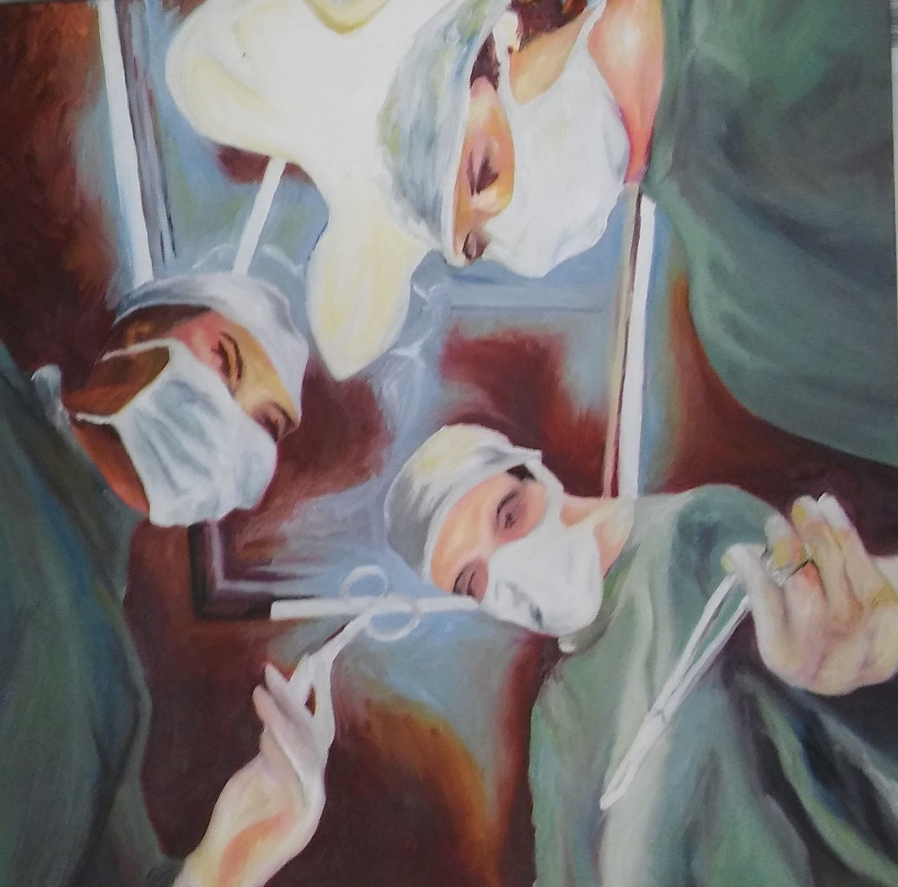
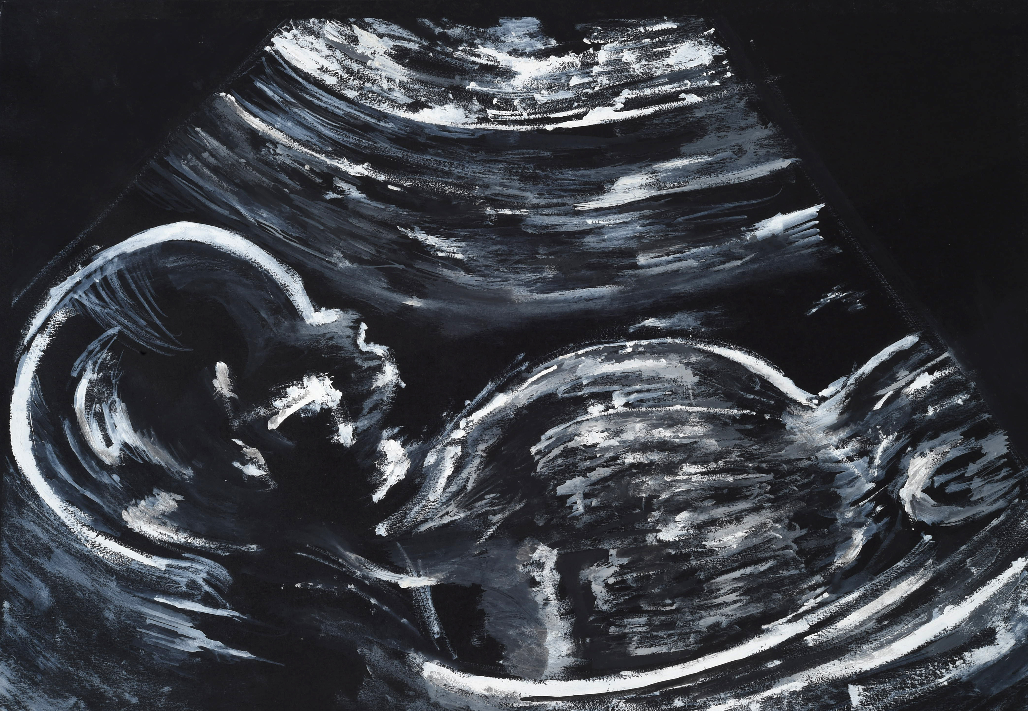
WHEN?
Undergraduate
Postgraduate
Notes:
So When?
Do we start with the embryonic healthcare professional as they enter into training? Or is this something for post qualification working postgraduate world?

Slide 11
Undergraduate
Professional socialisation
Stereotypical views
Time for Learning
Simulation not practice
Notes:
Readiness for IPL of students on admission to training has been seen to be high (work of Coster et al in UK ) and declines during time in training and therefore supports the idea of introducing IPL at start of professional education to capitalise on this. Interview study in Serbia suggested the majority of student had a positive attitude to the potential influence of IPL as an UG
coster et al Interprofessional attitududes amonst undergraduate students in the health professions: A longitudinal questionnaire survey - 4 annual surveys across 8 professions UK used Readiness for IPL scale (RIPLS)
considering Socialisation a factor in Relational domain of conceptual framework
Professional socialisation is the process of identification with a particular professional group acquiring the norms, values and attitudes associated with it. Although just beginning to develop their professional identity this can be a difficult time to have this challenged and can lead to people becoming tribal and inward looking about their professional identity which can undermine collaborative teamwork.
also
Stereotypical views of their own and other professionals are already in situ even before joining the training course, coster also measured strength of professional identity as high on entry to uni.
based on cultural, media, personal experiences and have influenced their choice of career.
That is not to say this is always a bad thing these can be positive
Doctors are knowledgeable and have all the answers
Nurses are caring and compassionate
Or Negative
Pharmacists are only interested in drugs not patients
Nurses unlike doctors don’t make decisions
One of the features of the psychological process of stereotyping is the out groups are considered homogenous this can be ffavourable as it suggests if we meet a member of another group/ profession and they do not fit the stereotype, as long as we see them as typical we may change our stereotypical view to accommodate them and apply this to all members of the out group. So there is the potential to change if we get in early and model positive attitudes and behaviours. Ateah et al suggests IPL can positively change perceptions of other professions
Canadian Ateah et al Stereotyping as a barrier to collaboaration: does IPE make a difference? Nurse education 2011 – used’ students stereotypes rating questionnaire’ (barnes 2000) before and after diffferent ipe interventions with nursing pharmacy medicine and dentistry. (prof competence, interpersonal skills, leadership, independence, teamplayer, confidence,academic,descision making.

Slide 12
Making connections
Notes:
We learn by making neural connections and the more we use these pathways the more we reinforce that learning
Getting to know each other and learning together is the beginning of a process to develop the right connections to build on so we do introduce 10 professions from 2 institutions to IPL in the first semester of their first year of training.

Slide 13
Undergraduate
Professional socialisation
Stereotypical views
Time for learning
Simulation not practice
Notes:
UG is the time dedicated to learning and although logistics working across different institutions, sites, aligning curricula and timetables are not insignificant they can be overcome if there is support for this endeavour such as we have in the collaboration ‘IPL aberdeen ‘
However we are only able to simulate practice/work as not yet qualified and full member of care team etc… is it real enough, can they function as that profession in any way yet is this relevant to their stage of training?

Slide 14
Building relationships
Notes:
We emphasise Building relationships for collaborative practice takes time and effort so that is why we bring them all together at this early stage in professional training in first term of year 1 Developing trust and respect using this example with students of a Mother and child
One of the first things we learn is to recognise our primary care giver usually our mother by their voice, face, smell
WE learn they are the person who feeds us who, cares and protects us and gives us a cuddle when we need one.
So we recognise learn their role and how that relates to us and our needs and role
This is the beginning of our relationship and it is central to our survival
Similarly we need to lay foundations for relationships that will benefit us as practitioners and our patients/clients. Which may even be Central to our patients survival

Slide 15
Postgraduate
Formed professional identity
Stereotypical views
Time to work
Practice Patient Safety
Notes:
So what about PG IPL ?
Again considering socialisation by this point we have more concrete ‘closed’ professional identity and may result in individuals whose primary loyalty is to their own profession which could be problematic. However if secure in own identity perhaps we will be in a more robust position to be have this challenged
Similarly stereotypical views may have been perpetuated in practice or through working with more individuals adapted and potentially have developed a more nuanced understanding
But often both identity and views of other professionals are taken for granted by this stage and not considered, reflected on or discussed in the literature but have tremendous influence on behaviour and practice
Now although together working in teams the focus is on the delivery of care and personal learning is often marginalised so to find the time to do this can be problematic.
But at least now in practice this is real and the driver of improving patient care and patient safety concerns do act as important factors for making time – my colleague will talk about how IP is part of everyday practice perhaps it need not be about more time but how we use the time we have.

Slide 16
Inter Professional Learning
WHEN? – Early Undergraduate & Postgraduate
HOW?
WHAT?
Notes:
So there is value in early interventions and ongoing interventions in postgraduate practice environment with established teams as part of continued professional development
So now turning to the
HOW? And WHAT

Slide 17
Conceptual framework for Interprofessional teamwork
Relational
Professional power
Hierarchy
Socialisation
Team composition
Team roles
Team processes
Processual
Time and space
Routines and Rituals
Information technology
Unpredictability
Urgency
Complexity
Task Shifting
Interprofessional teamwork
Organisational
Organisational Support
Professional representation
Fear of litigation
Contextual
Culture
Diversity
Gender
Political will
Economics
Adapted from Reeves et al. 2010
Notes:
Just to return to the framework for understanding IP teamwork and the factors in each of the 4 domains
Obviously too much to cover today but I want o focus on some Relational factors. Context is very important but mine will be different from your own and there are micro contexts and cultures within healthcare services. Organisational almost a subset of the context
Processual factors relate well to IPL interventions in practice some examples of which my surgical colleague will give shortly

Slide 18
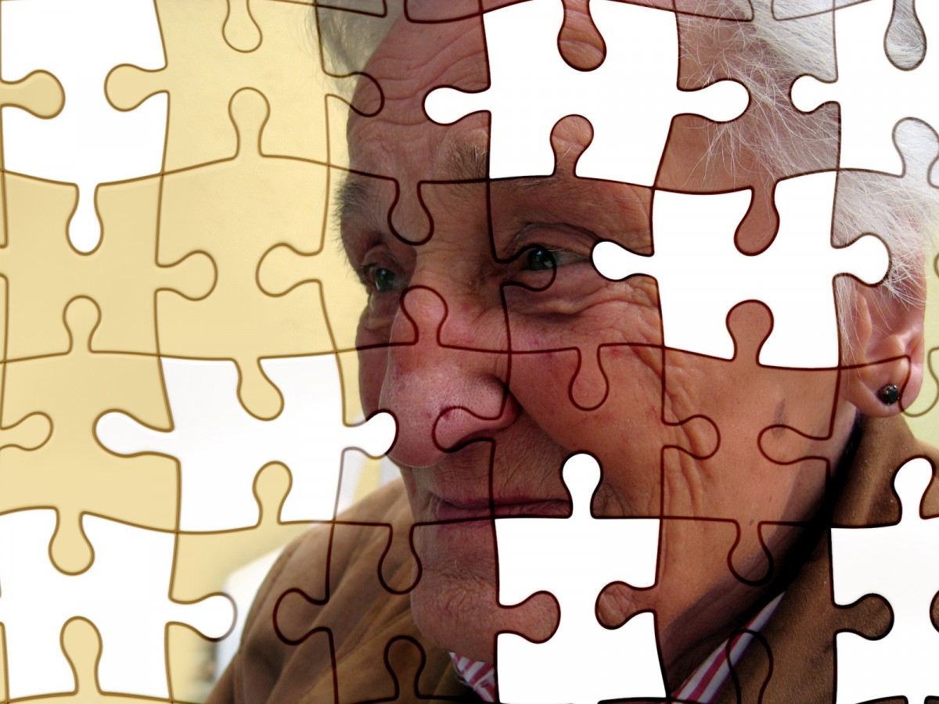
Relational Domain
Professional power
Hierarchy
Socialisation
Team composition
Team roles
Team processes
Notes:
Of the relational factors I have spoken about socialisation in the When already
Move on to team composition The how to do it and team processes the what to do

Slide 19
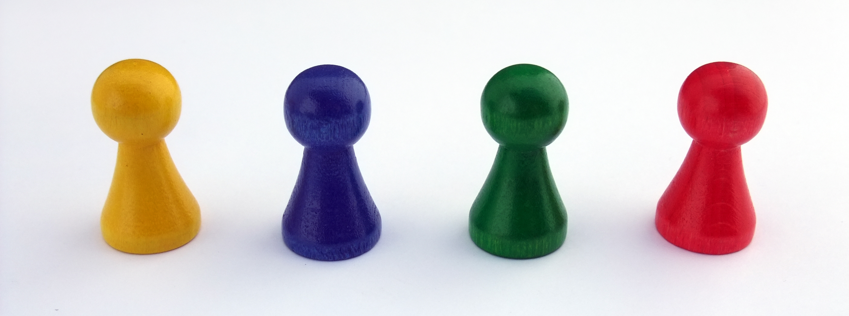
HOW?
Large groups
Small groups
?
Notes:
How big
Large unwieldly and can lead to sub group formation and the danger might be this being along professional lines
But opportunity for wider talent, skills and knowledge to contribute
group size SGT number from educational view around 8 smaller can allow more in depth but can be skewed by individuals and in the case of IPL by individual profession

Slide 20
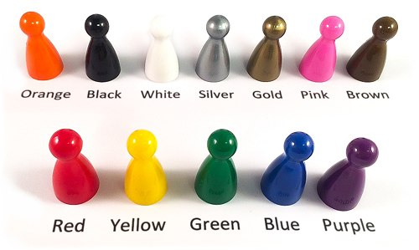
HOW?
All professions
Limited professions
?
Notes:
and composition
Relevant and realistic
Carpenter and Dickenson speak about contact variables including generalisation which is problematic with early interventions y1 with students not yet being able to represent their profession as not yet possessing knowledge and skill
Also balanced representation as large numbers of some professional and only a handful of others making them possibly sole rep of their profession can mean they are targeted or simply overwhelmed by responsibility to speak for ‘ot’ etc…
Authentic activities relevant to future practice. Might mean only ltd professions nursing/medicine/pharmacy perhaps however all professions are needed to be cohesive so they need to be involved whenever possible, as relevant or in generic learning opportunities

Slide 21
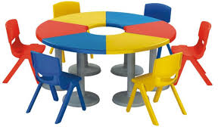
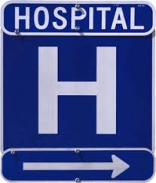
HOW?
Classroom
simulation
Practice
?
Notes:
In classroom or in practice?
In classrooms this may be case discussions and be carefully planned, constructed and facilitated to ensure potential for positive learning
In practice need to have well-developed collaborative culture in host department – role modelling. some lend themselves more to it than others. Practice educators trained and confident in recognising IPL opportunities – students cannot be left to do it themselves.
An in between option is simulation which is used effectively for resuscitation training IPL intermediate lifesupport in Aberdeen. We offer simulated ward which includes management of critical ill patient as well as ward rounds.
This can also be provided in modified practice settings such as the Training wards staffed in scandinavia and germany (Heidelberg) by snr nursing and medical students but only during the day and with structured format under supervison of host ward.
Each environment providing different conditions for learning

Slide 22
WHAT?
Action
Reflection
?
Notes:
What to do
Bringing students together, Contact alone not enough even integration of service in practice not going to effect collaborative practice there needs to be active positive engagment and immersion in collaborative activities together
(allport 1954 contact alone insufficient)
Factor of Individual willingness is significant here – positive expectations we have tried to utilising student ambassadors and our student IPE society
About doing things but must also be about reflecting on them and thinking not only what we do but why and how we can change to be more effective, efficient and safe.
Reflection is a skill central to the learning and practice of some professions and relatively new to others but is at the heart of IPL

Slide 23
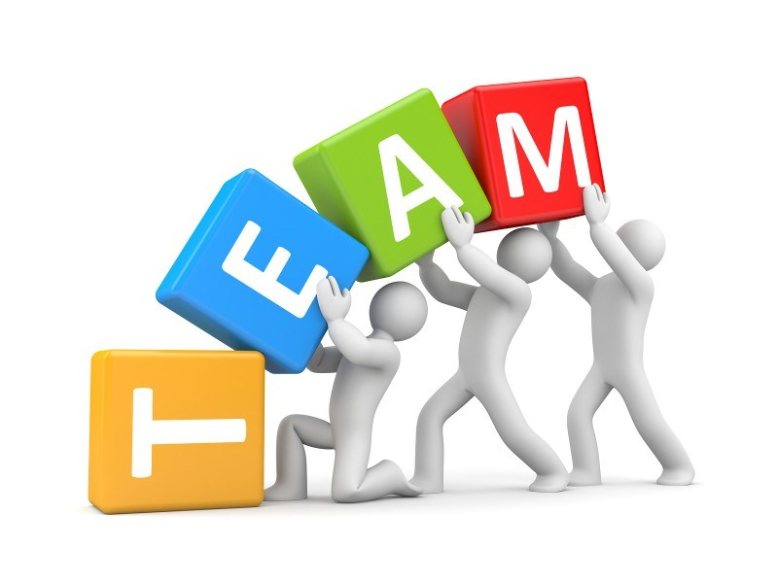
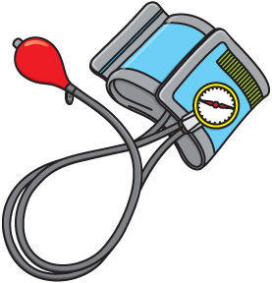
WHAT?
Generic
?
Clinically Applied
Notes:
Turning to the what and this is all about team processses
Carpenter and Dickenson 2016 Contact variables equal status, common goals, positive expectations (ambassadors) institutional support (inc assessment) generalisation (taking the role of prof discipline early yrs deemphasise), balanced number of professions
Generic vs clinically applied
In our experience in Aberdeen Medical students swing between wanting it to be more like clinical practice and real – high fidelity, full team, expensive simulation. For example developing communication skills through generic team building or as we have in Aberdeen low tech simulation communication structure (SBAR) handovers
Generic be necessary at the early stage about team work skills and team building games. As mentioned before relates to what professions representated being realistic or contrived. As progress becoming more specific and clinically relevant, realisitic and valid
However there is still an important place for team building opportunities in PG to enable continued relationship building, development of trust and respect and not to overlook even novelty is a factor can be important to help engagement.
Ultimately collaboration will only happen if there is individual willingness and the same for IPL intervention. So for some involvment in a generic team building event may be seen as irrelevant and for others something different focusing on interpersonal skills not clinical knowledge and creating a level playing field for all members of the team. Returning to the contact variable of equal status

Slide 24
WHAT?
Safe but idealised
Open but danger
?
Notes:
You could describe the ideal team talk about ambition overlooking obstacles in the way. Teacher centred more didactic these are the recommendations but not current reality. May have a place in the context of early in training, newly formed teams but as an opportunity for ip learning this is limited. It ignores the fact that it is more complex, uncertain and changing.
Rather we need to facilitate a more learner centred approach that creates a space for discussion and potential conflict but uses this positively to allow for transformative learning where as Mezirow describes we reconstruct our understanding, innovate and move forward. Turning conflict into constructive learning requires trust and respect in team and of facilitator. The later however is not without risks and needs to be supported by expert IPL facilitating faculty who are able to set aside their own professional allegiances and are skilled in IPL facilitation. Sadly the training of facilitators to undertake this is often taken for granted or omitted

Slide 25
Inter Professional Learning
WHEN? – Early Undergraduate & Postgraduate
HOW? – Group and environment
WHAT? – Open, active &
reflective
Notes:
So in conclusion
WHEN? Arguments for starting early in UG but continuing into practice environment and postgraduate world of work
HOW? Need to consider group size and composition, utilising classroom, simulation and practice environments and based on sound educational principles with individual engagement essential to the learning
WHAT? Generic and applied opportunities have their place but identification and management of learning needs to foster openess to provide positive transformational learning experiences. Again active participation and engagement with reflection embedded are required for success.

Slide 26
References
Way D O, Busing N and Jones L (2002) Implementing Strategies: collaboration in primary care – family doctors and nurse practitioners delivering shared care. Ontario College of Family Physicians, Toronto.
The Centre for the Advancement of Interprofessional Education (CAIPE) https://www.caipe.org/
WHO (2010) Framework for Action on Interprofessional Education & Collaborative Practice
Kirkpatrick . (1994) Evaluating Training Programmes
Reeves, Scott & Lewin, Simon & Espin, Sherry & Zwarenstein, Merrick. (2010). Interprofessional Teamwork in Health and Social Care.
Coster et al. (2008) Interprofessional attitududes amonst undergraduate students in the health professions: A longitudinal questionnaire survey . International Journal of Nursing Studies, 45, 1667-1681
Ateah et al. (2011) Stereotyping as a barrier to collaboration: Does IPE make a difference? Nurse Education Today, 31, 208-213
Carpenter and Dickenson. (2016) Interprofessional education and training.
Granheim, Shaw and Mansah (2018) The use of interprofessional learning and simulation in undergraduate nursing programs to address interprofessional communication and collaboration: An integrative review of the literature.

Slide 27
Questions / Discussion

